Slide 1

“Strax” — Advancements in Topic Modeling
Technische Universität München
Fakultät für Informatik
NLP Lab Course, SS22
22.06.2022
Berk Sudan, Ferdinand Kapl, Yuyin Lang

Slide 2
Overview
Datasets Exploration (Milestone #1)
Preprocessing Steps (Milestone #2)
Algorithms (Milestone #3 & #4) with Evaluation
LDA/NMF
Top2Vec & Visualization
BERTopic & Visualization
Comparison (Milestone #6)
Road Map
‹#›

Slide 3
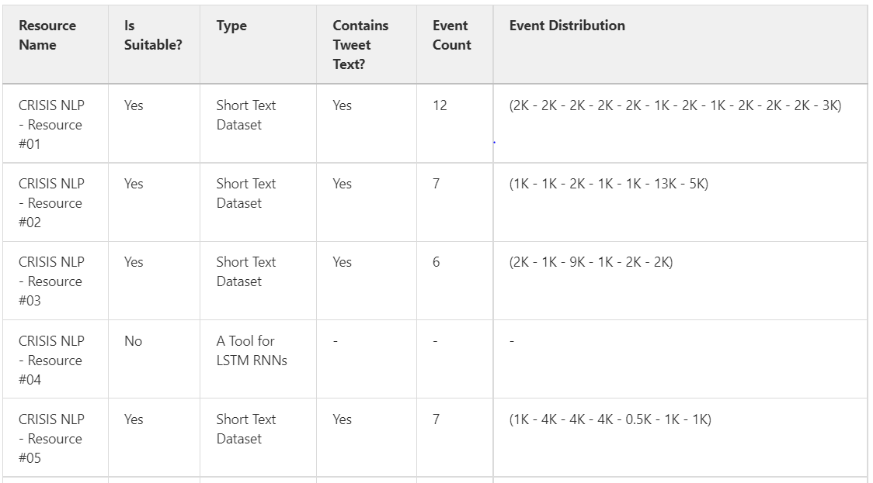

Datasets Exploration (Milestone # 1)
Short dataset
…
…
‹#›

Slide 4
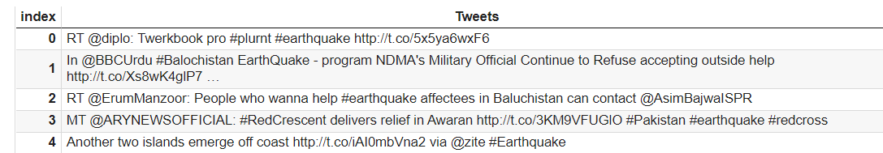
Datasets Exploration (Milestone # 1)
They are tweets
Often less than 30 words
Contains lots of websites and urls
‹#›

Slide 5
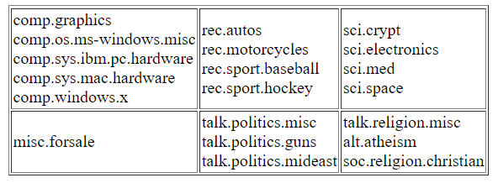
Datasets Exploration (Milestone # 1)
Long dataset
20 Newsgroups
Roughly grouped into 6 big topics
May overlap between small topics
‹#›

Slide 6
Preprocessing steps (Milestone # 2)
For crisis dataset
Specially for OCTIS initialization
‹#›

Slide 7
Algorithms (Milestone # 3 & 4)
LDA / NMF
Top2Vec
BERTopic
‹#›

Slide 8
LDA / NMF
‹#›

Slide 9
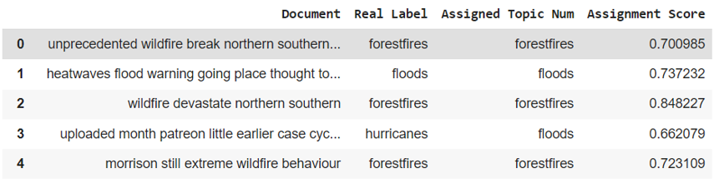
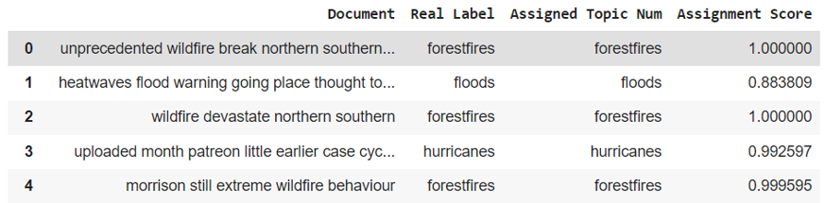
LDA/NMF on crisis dataset 12
Doc-Topic Output
LDA:
NMF:
Gives higher scores than LDA
‹#›

Slide 10
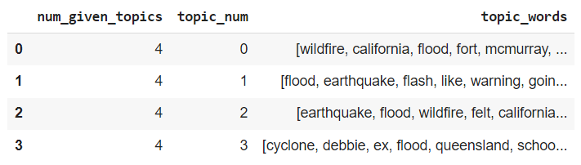
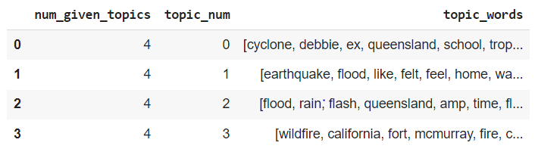
LDA/NMF on crisis dataset 12
Topic-Word Output
LDA:
NMF:
‹#›

Slide 11
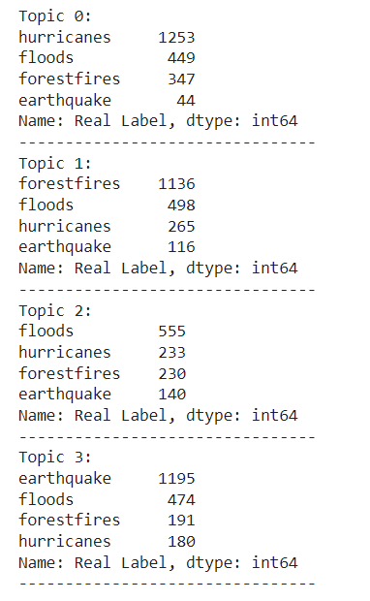
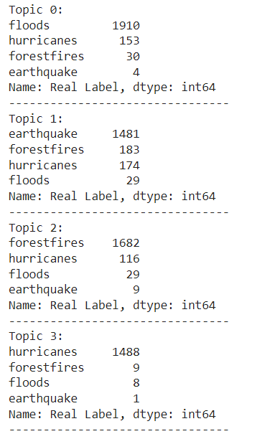
LDA/NMF on crisis dataset 12
Documents in topics
LDA:
NMF:
‹#›

Slide 12
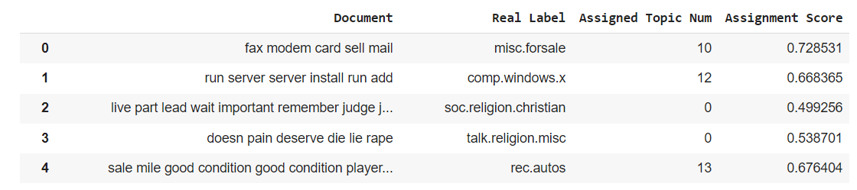
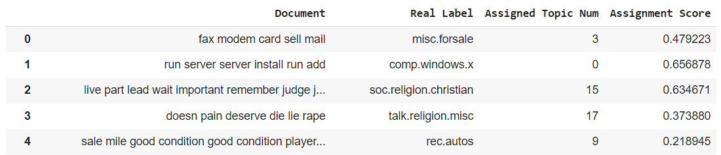
LDA/NMF on 20 News Dataset
Doc-Topic Output
LDA:
NMF:
‹#›

Slide 13
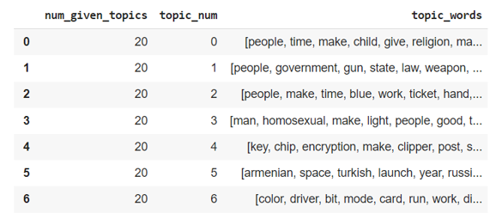
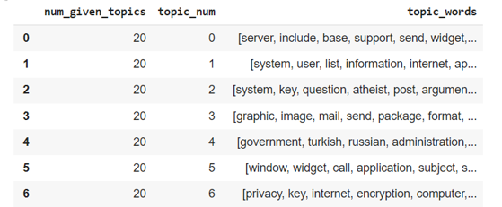
LDA/NMF on 20 News Dataset
Topic-Word Output
Not very informative :(
LDA:
NMF:
‹#›

Slide 14
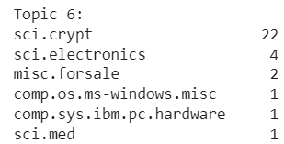
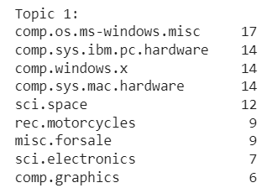
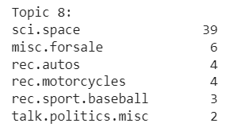
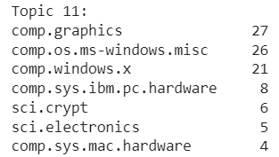
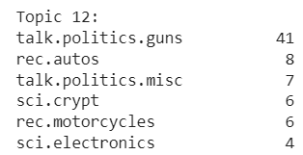
NMF on 20 News Dataset
Documents in topics
‹#›

Slide 15
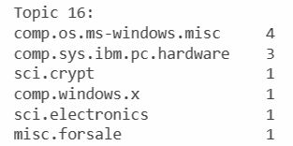
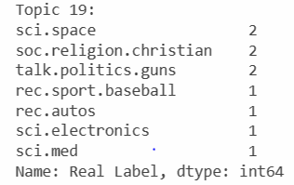
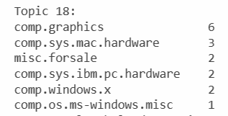
NMF on 20 News Dataset
Documents in topics
‹#›

Slide 16
Top2Vec
‹#›

Slide 17
Top2Vec - Available Parameters
Dataset
Minimum Topic Words: Depends on corpus size and its vocabulary.
Embedding Model: 8 models tested
umap_args:
# of Neighbours
# of Components
Distance Metric
hdbscan_args:
Minimum Cluster Size
Distance Metric
Cluster Selection Method
Number of Topics: To force Topic Reduction

Slide 18
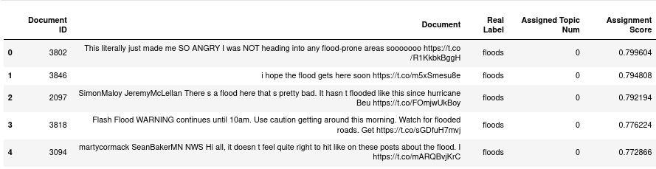
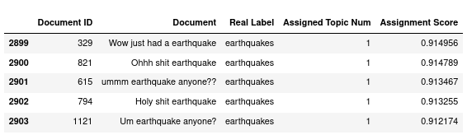
Top2Vec - Topic Assignments
Parameters: Embedding=”universal-sentence-encoder-large”, Data=”CRISIS-12”
Assignment Score: The cosine similarity of the document and topic vector.
‹#›

Slide 19
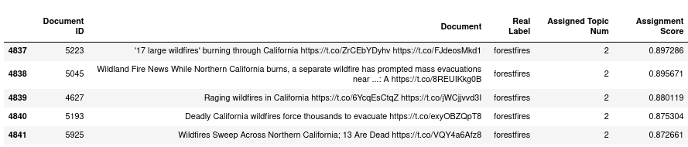
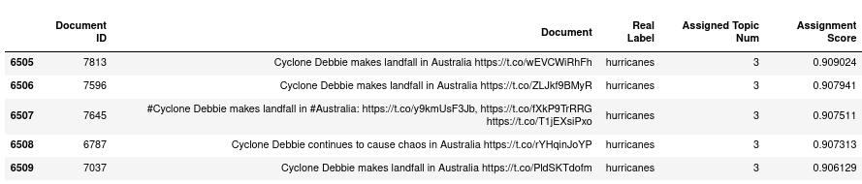
Top2Vec - Topic Assignments Pt. 2
Parameters: Embedding=”universal-sentence-encoder-large”, Data=”CRISIS-12”
Assignment Score: The cosine similarity of the document and topic vector.
‹#›

Slide 20
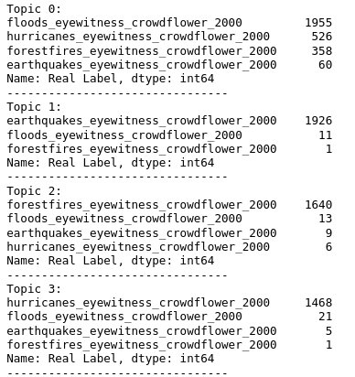
Top2Vec - Evaluation
Diversity Score : 0.5500
Coherence Score: 0.4860
Parameters: Embedding=”universal-sentence-encoder-large”, Data=”CRISIS-12”
Assignment Score: The cosine similarity of the document and topic vector.
‹#›

Slide 21
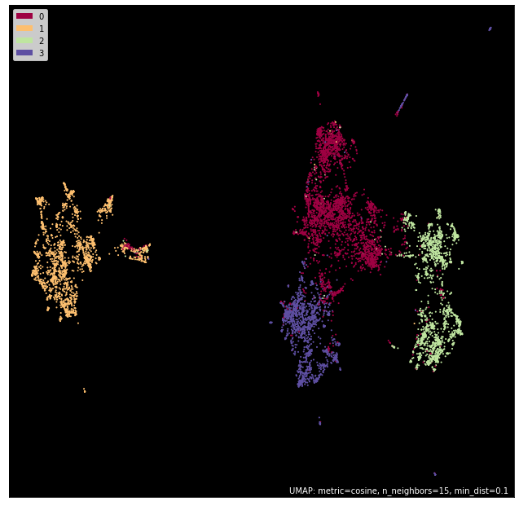
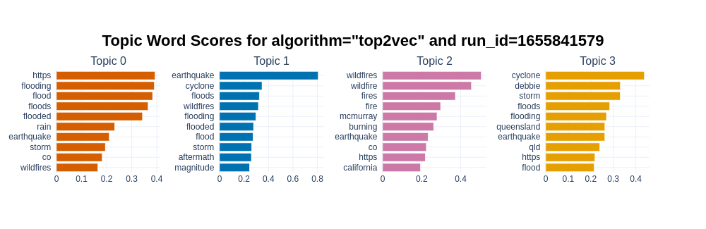
Top2Vec - Visualization
Parameters: Embedding=”universal-sentence-encoder-large”, Data=”CRISIS-12”
Word Score: The cosine similarity of the document and topic word.
‹#›

Slide 22
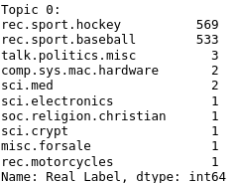
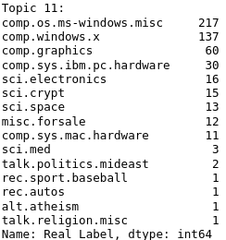
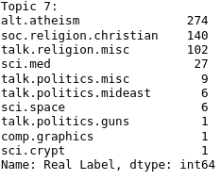
Top2Vec - Evaluation - 20News
Diversity Score : 0.8750
Coherence Score: 0.3797
Observation: Similar labels in the same topic
‹#›

Slide 23
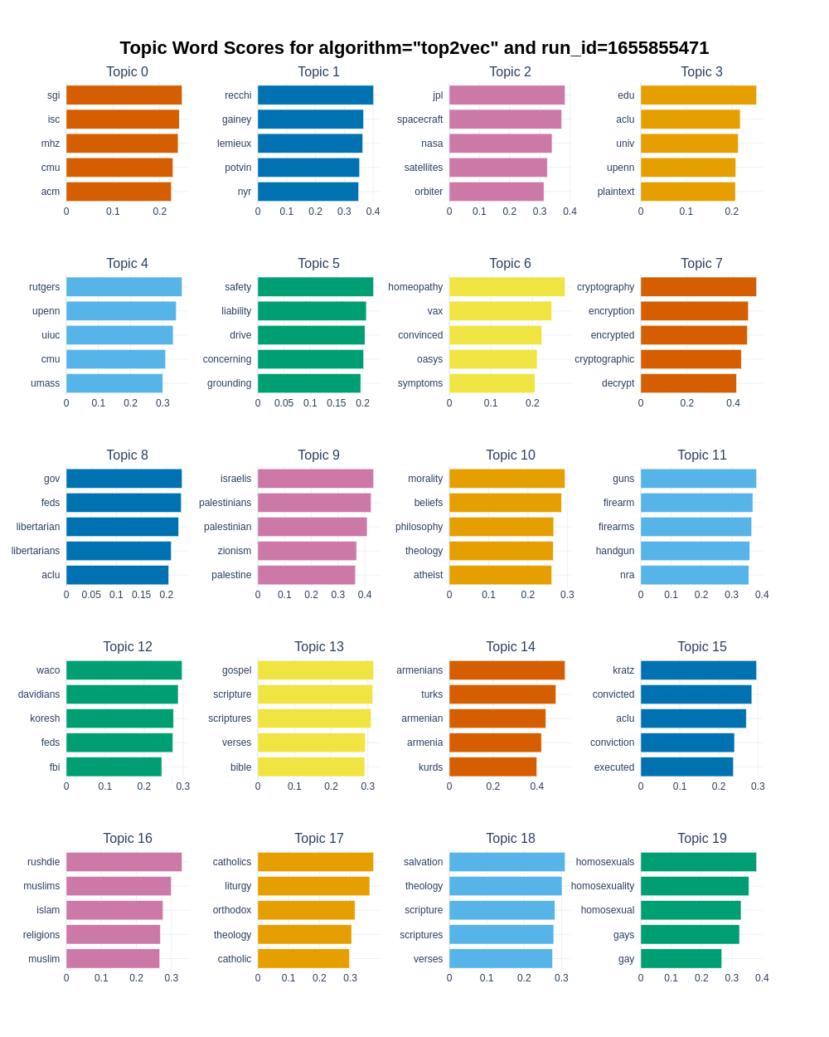
Top2Vec - Visualization - 20News
Observation: Similar words in the same topic
‹#›

Slide 24
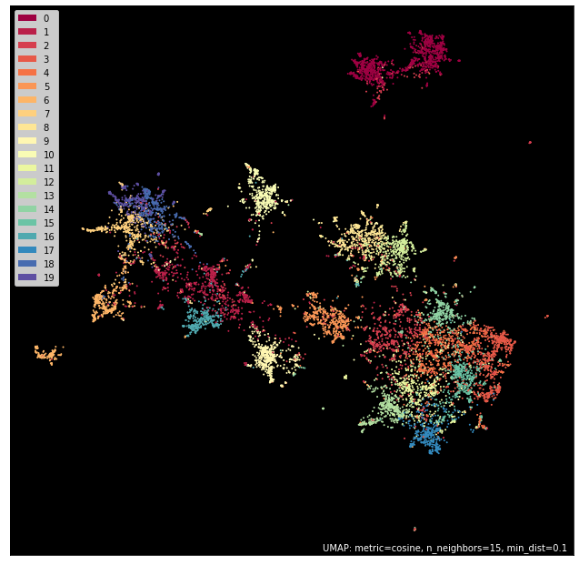
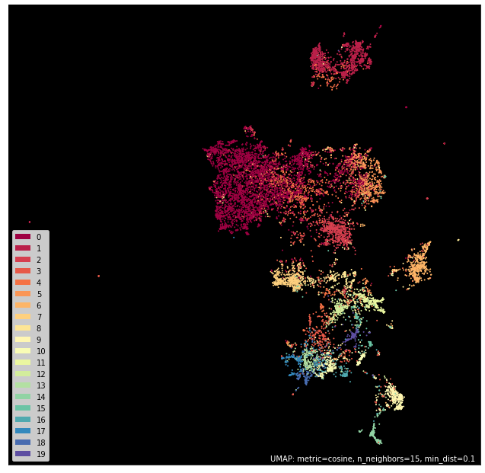
Top2Vec - Visualization - 20News
universal-sentence-encoder
all-MiniLM-L6-v2
‹#›

Slide 25
Top2Vec - Initial Comparison
Data | Embedding Model | Diversity Score | Coherence Score
CRISIS-12 | universal-sentence-encoder-large | 0.5500 | 0.4860
CRISIS-12 | all-MiniLM-L6-v2 | 0.7000 | 0.3783
20news | all-MiniLM-L6-v2 | 0.8750 | 0.3797
20news | universal-sentence-encoder | 0.8650 | 0.3757
Also: In small text, more irrelevant topic words due to sparsity
‹#›

Slide 26
BERTopic
‹#›

Slide 27
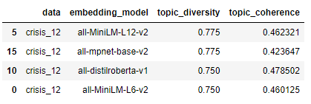
BERTopic - Experiments
So far: four embedding models and the three datasets with & without preprocessed crisis datasets
Often: No clear winner and performances are close (care: only one run)
‹#›

Slide 28
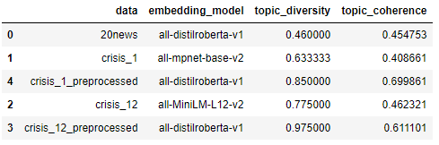
BERTopic - Experiments: Best Results
Again: No clear winner Different embeddings achieve best results
‹#›
Notes:
Best results are really the best except crisis 12 & 20 news;
Unprocessed VS Preprocessed: care for comparing topic_coherence (measured on text so it changes with the used data)

Slide 29
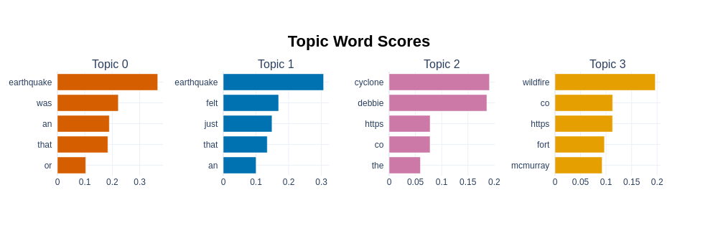
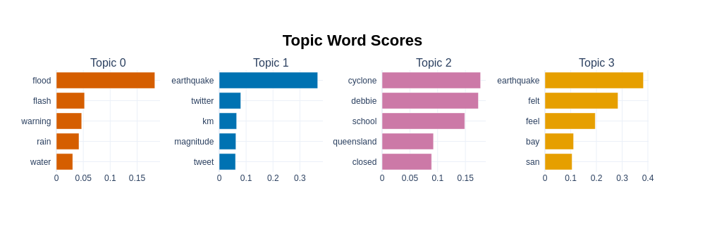
BERTopic - Compare Best Results on Crisis 12
Unprocessed
Crisis 12
Preprocessed
Crisis 12
Impression: Topic words for the preprocessed version are more descriptive
‹#›
Notes:
Preprocessed topic words are more descriptive;
significant drop in word score after the first topic word for some topics;
NO FORESTFIRE Topic

Slide 30
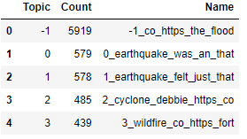
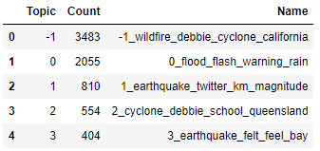
BERTopic - Results on Crisis 12: Doc Distribution
Unprocessed
Crisis 12
Preprocessed
Crisis 12
Problem: Many docs classified as “noise” (especially for unprocessed dataset)
‹#›
Notes:
Solution? -> Higher number of topics
Same for 20 news: many docs classified as noise and topic words contain many stop words (the, in, of, to, …)

Slide 31


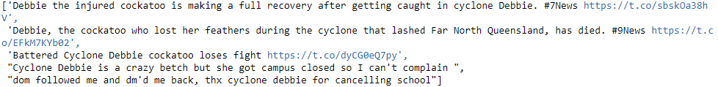
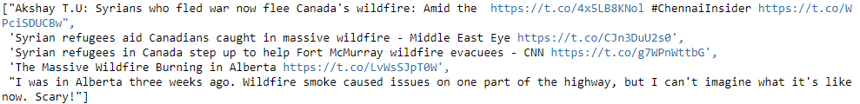
BERTopic - Results on Crisis 12: Documents
Unprocessed
Crisis 12
‹#›

Slide 32
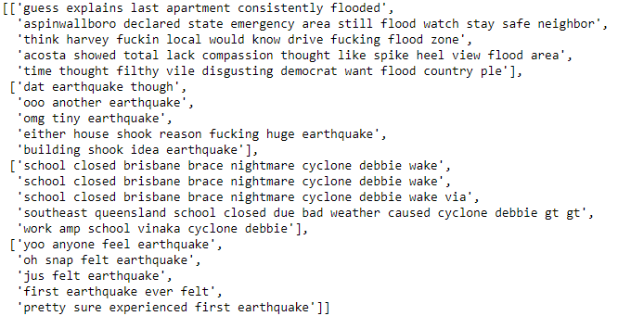
BERTopic - Results on Crisis 12: Documents
Preprocessed
Crisis 12
‹#›

Slide 33
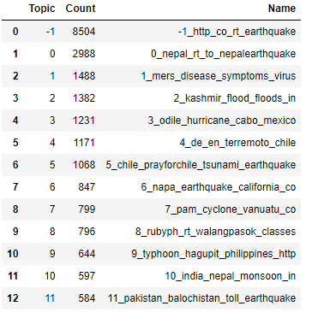
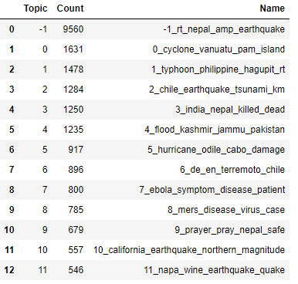
BERTopic - Compare Best Results on Crisis 1
Unprocessed
Crisis 1
Preprocessed
Crisis 1
‹#›
Notes:
Same for Crisis 1: many docs classified as noise, but topic words not as bad

Slide 34
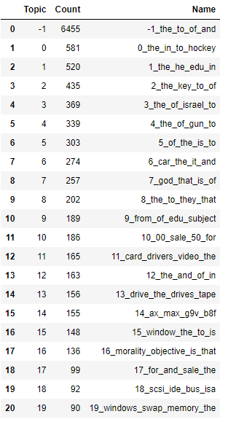
BERTopic - Distribution for 20News
‹#›
Notes:
Solution? -> Higher number of topics

Slide 35
Comparison
‹#›

Slide 36
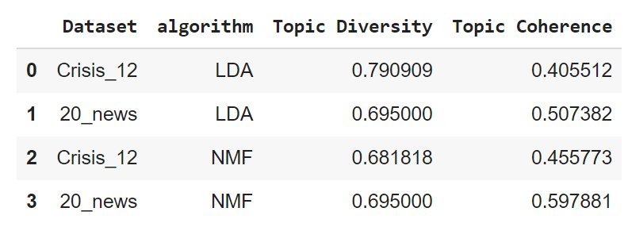
Data | Embedding Model | Diversity Score | Coherence Score
CRISIS-12 | universal-sentence-encoder-large | 0.5500 | 0.4860
CRISIS-12 | all-MiniLM-L6-v2 | 0.7000 | 0.3783
20news | all-MiniLM-L6-v2 | 0.8750 | 0.3797
20news | universal-sentence-encoder | 0.8650 | 0.3757
Quick Comparison
‹#›
Notes:
Solution? -> Higher number of topics

Slide 37
* Uses preprocessed data; other algs unprocessed (BERTopic preprocessed in parenthesis)
Quick Comparison
20News
Crisis 12
Algorithm | TC | TD | TC | TD
NMF* | 0.598 | 0.695 | 0.456 | 0.682
LDA* | 0.507 | 0.695 | 0.406 | 0.791
BERTopic [all-distilroberta-v1] | 0.456 | 0.460 | 0.479 (0.611) | 0.750 (0.975)
BERTopic [all-MiniLM-L12-v2] | 0.502 | 0.360 | 0.462 (0.556) | 0.775 (0.925)
BERTopic [all-mpnet-base-v2] | 0.456 | 0.430 | 0.424 (0.561) | 0.775 (0.975)
Top2Vec [all-MiniLM-L6-v2] | 0.380 | 0.875 | 0.378 | 0.700
Top2Vec [universal-sentence-encoder] | 0.376 | 0.865 | - | -
Top2Vec [universal-sentence-encoder-large] | - | - | 0.486 | 0.550
‹#›

Slide 38
Road Map
‹#›

Slide 39
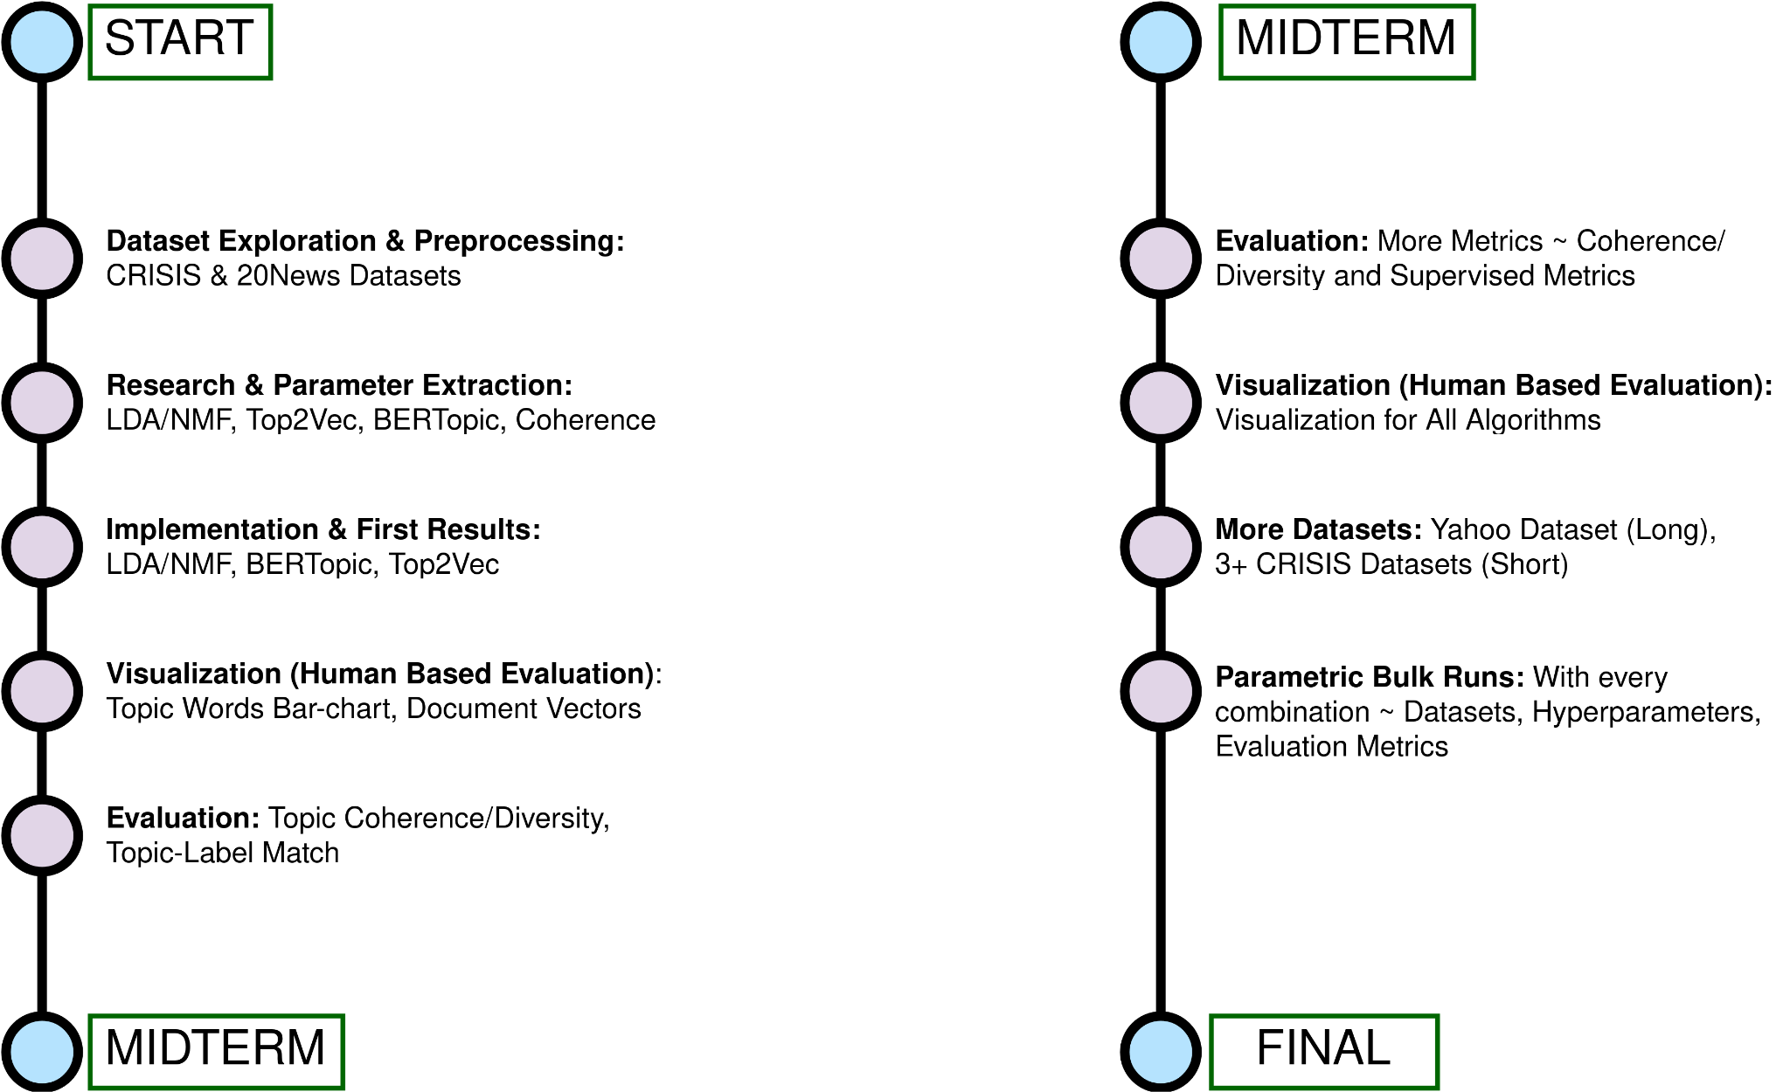
Road Map
Optional: 1-2 New Algorithms ~ CTM and/or LDA-Bert
‹#›

Slide 40
Q & A
‹#›

